Slide 1
ESG Rating Platform
EY Sustainable Finance Solution Proposal for IBM-EY Call for Code ESG Challenge
Nov 2021

Slide 2
ESG data transparency platform enabling FIs’ evaluation of borrowers for Green Loans/Sustainability-Linked Loans
Problem Statement
Sustainable finance lead to increased longer-term investment into sustainable economy by taking due account of environmental, social and governance (ESG) considerations.
The emergence of Green Loans and Sustainability-Linked loans have enabled borrowers avenues to finance their sustainable initiatives at a lower interest rate, and lenders opportunities to improve public opinions and diversification of portfolio with potentially lower credit risks. Specifically in Singapore, central bank Money Authority of Singapore’s (MAS) Green and Sustainability-Linked Loan Grant Scheme (GSLS) aims to support corporates in accessing financing as they invest in green projects, and move towards more sustainable business models
However, without clear rules on disclosure and auditing standards to validate ESG data – lenders have to rely solely on information voluntarily disclosed by firms for the assessment on eligibility of candidates for GSLS
Proposed solution seeks to provide a platform to enable FIs to efficiently assess companies’ eligibility for GSLS through the aggregation of ESG data (structured (i.e. company documents etc.) and unstructured (i.e. external news, annual report etc.)) and matching against defined international principles
Project Objective
Solution Overview
To provide a platform enabling ESG transparency of Sustainable Financing candidates for FIs to leverage for green loans & bonds’ eligibility evaluation
To increase process efficiency of evaluating and reduce turn-around rate of issuing SLL
To reduce default rate/funds allocated to loanees who are unable to meet the sustainability requirements
“ESG Rating Platform” – aggregator of structured and non-structured data of companies engaging in manufacturing/production
Feature 1: ML-driven data aggregation (NLP, CV etc.)
Feature 2: BI/application to evaluate ESG maturity of companies for ESG financing (i.e. prediction of ESG loans default, credit worthiness etc.)
Architecture Diagram that enables “ESG Rating Platform”
E2E (starting from data scraping/ingestion to BI visualization) leveraging on IBM cloud services

Slide 3
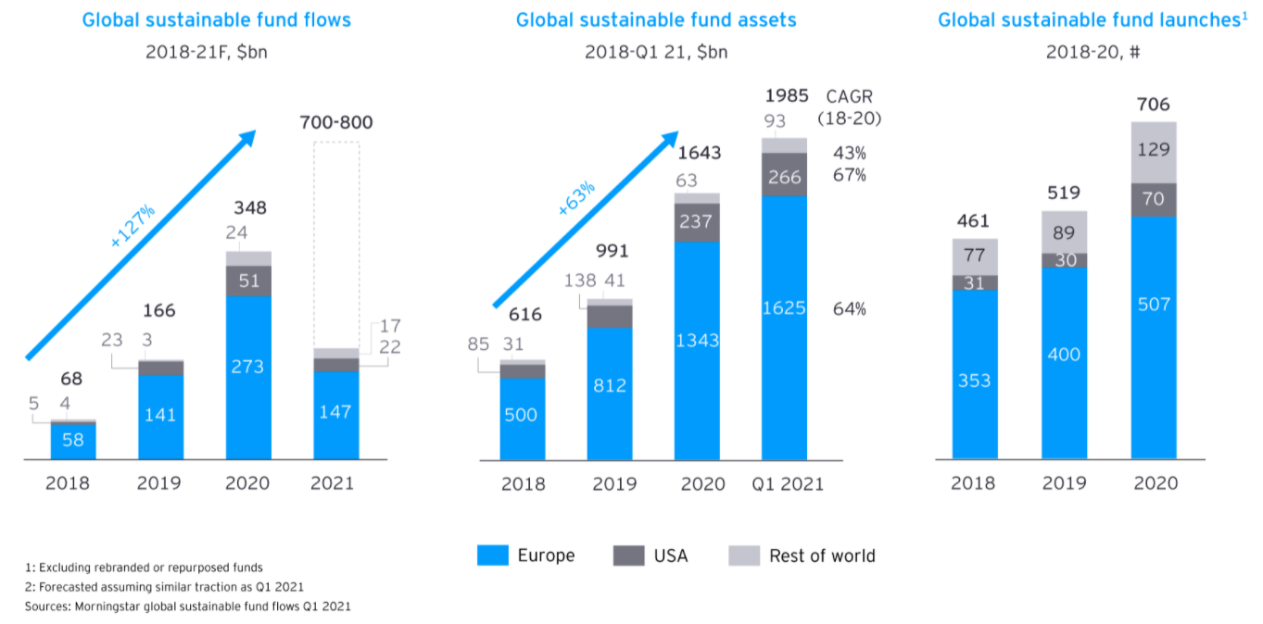



Worldwide tidal wave of sustainability funds and green finance boost the request of standardized and structured ESG rating platform
The increase of assets flowing into ESG funds has been dramatic. As of December 2020, passive funds constituted roughly 22% of the European sustainable fund universe by assets under management (AuM).
Assets in ESG exchange traded funds (ETFs) closed the year at EUR 82.5b, up from EUR 32.1b in 2019, an increase of 156%. Such ETFs are becoming an effective tool for investors seeking to benefit from the trend of governments, companies and asset managers committing to achieve net-zero targets by 2050
EU disclose Green Bonds and Sustainability-Linked Bonds
Allow companies and public bodies to more easily raise large-scale financing for climate and environmentally-friendly investments
Protect investors from greenwashing
Multiple banks and local govt. issue green bonds and loans
Bank of America has issued 8 ESG-themed corporate bonds since 2013
HSBC expands its sustainability-linked loan offering to U.S. business
Monetary Authority of Singapore launch Green and Sustainability-Linked Loans Grant Scheme
Defray the expense of engaging independent sustainability advisory and assessment service
Accessible to all corporates, including SMEs

Slide 4

ESG Rating Platform assist to demonstrate alignment of loans with internationally recognized principles
The proposed ESG rating platform solution integrate company’s ESG metrics into loan evaluation process, and demonstrate how business model and activities align with UN Sustainable Development Goals. ESG metrics include ESG Proceeds evaluation for green loan process and sustainability performance targets (SPTs) measurement for sustainability linked loan process.
Green Loan Principles (GLP)
Green Loans aim to facilitate and support environmentally sustainable economic activity and are made available to finance eligible Green Projects. Core components of GLP include:
Use of Proceeds
Process for Project Evaluation and Selection
Management of Proceeds
Reporting
Sustainability Linked Loan Principles (SLLP)
Sustainability linked loans look to improve the borrower’s sustainability profile by aligning loan terms to the borrower’s performance against the relevant predetermined SPTs. Below are the core components of SLLP:
Selection of KPIs
Calibration of SPTs
Loan Characteristics
Reporting
Verification

Slide 5


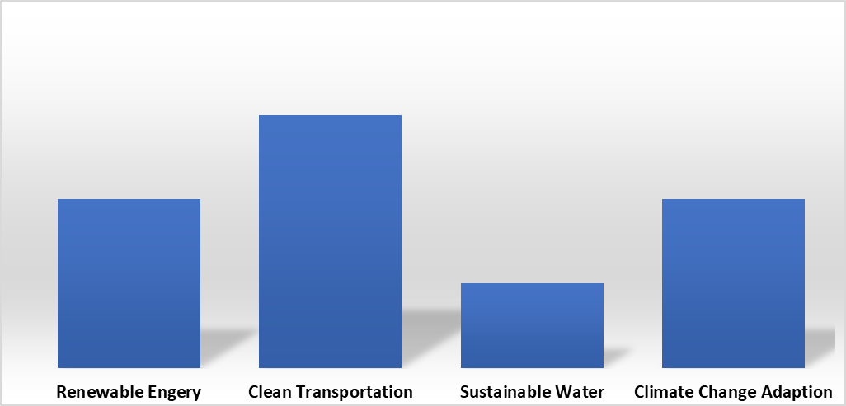
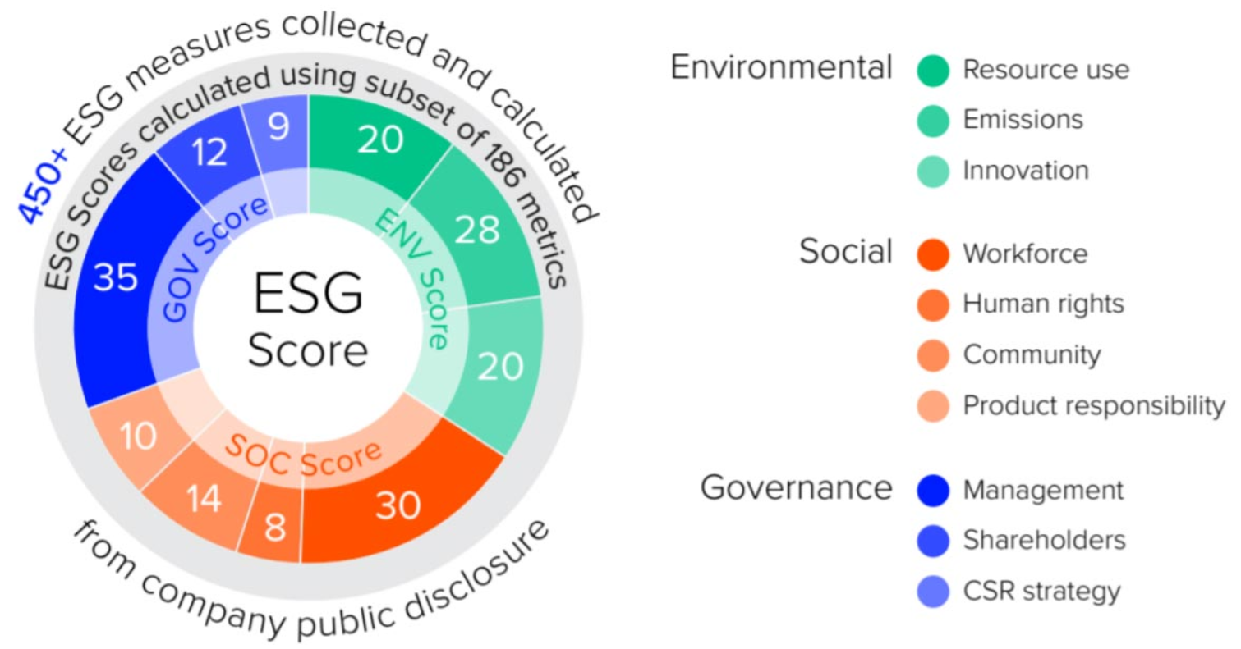






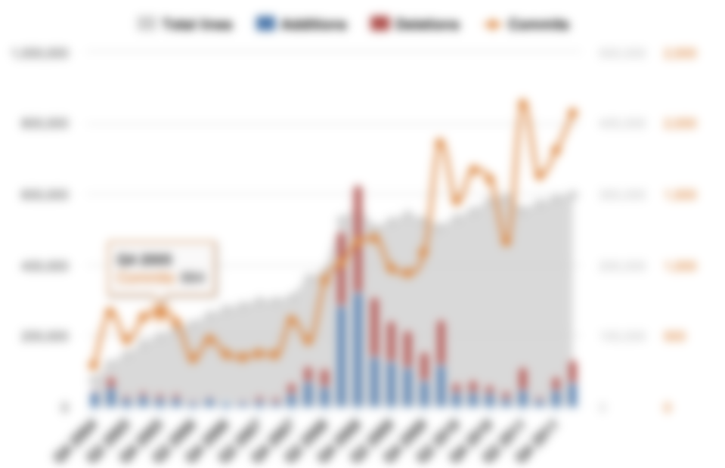
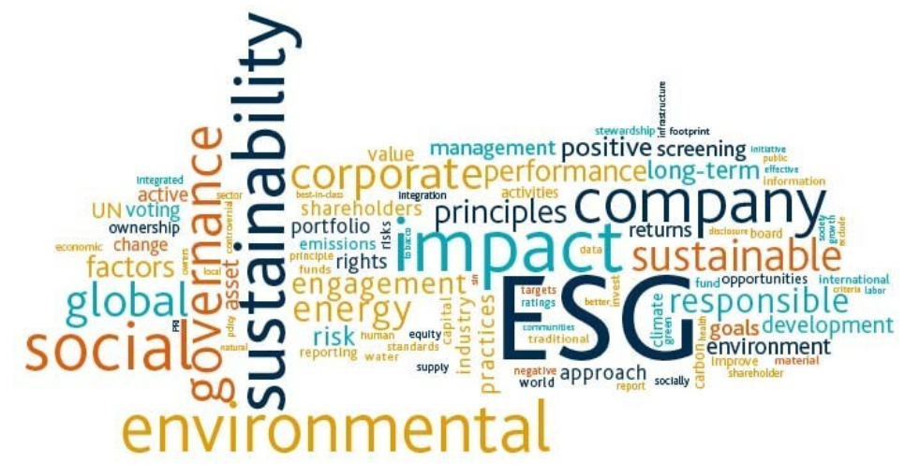
Proposed ESG Rating dashboard targets to consolidate all ESG rating performance and financial figures
Green Projects review with Proceeds
External ESG rating scores
Source: Company documents
Summarise project scope and expected impact
Mapping projects to Indicative Categories of Eligibility for Green Projects and respective allocation of Proceeds amount
Source: Third party rating agencies or auditing reports
Complement the ESG rating with verification or certification from Sustainability Advisory and Assessment Work
Allocation of Proceeds
Illustrative
Illustrative
Proceeds Utilization Tracking
Social ESG sentiment analysis results
Source: company financial reports
Track the utilization of Proceeds along timeline in different eligible categories
Define and maintain both qualitative and quantitative performance measures
Verify the attainment of the SPTs
Source: news, social media, third party rating reports
Replenish the company’s sustainable performance with social media information
Evaluate the sentiment of public news and social media on topics of eligible categories
Illustrative
Illustrative
Utilisation of Proceeds

Slide 6









E2E Architecture comprises of key components on ETL, Analytics and Business Intelligence leveraging on IBM Tools
1
4
Data Sources
Use Case 1 : Green Loan Eligibility Evaluation
Rating Agencies
News Articles
IBM Machine Learning
IBM Natural Language Understanding
IBM Machine Learning
IBM Cognos Dashboards
SASB Reports
Annual Reports
Feature Engineering
NLP
ML
5
Corporate Websites
3
5
Data Storage
Use Case 2 : Sustainability Linked Loan Evaluation
2
Regulatory Organizations (ICMA, GSLS etc.)
Green Loans Principles (GLP) Eligibility Criteria
IBM Cognos Dashboards
IBM File Storage
Sustainability Linked Loan Principles (SLLP)
Eligibility Criteria
1
2
3
Storage of raw data in IBM file/block storage
4
5
Data sources providing ESG data such as SEC filings, SASB reports, Rating agencies etc.
Eligibility criteria for Green Loans/ Sustainability Linked Loan by regulatory organizations such as ICMA
Using native IBM Analytics services to perform feature engineering, NLP and model training
Evaluation of Green Loans & Sustainability Linked Loan eligibility

Slide 7


Platform Features such as Data Storage, AI/ML and Dashboarding are built leveraging on IBM
Data Flow and Processing on IBM Cloud
Data Input and Storage
Natural Language Processing
Machine Learning
Dashboard
Data Sources:
-Annual reports
Include information about business activities, ongoing and planning projects and Proceeds spending
-Rating/ Auditing agency
Provides ESG rating scores and financial statement like SEC filings, SASB figures etc.
-News Articles
Web scrape company’s news articles in social media website
-Eligibility Criteria
Update and archive latest Global/ Local GLP, GBP, SLLP eligibility criteria
Data Storage:
Store structured and unstructured data in IBM File Storage, design metadata and set documentation
Entity Extraction:
Leverage Watson Natural Language Understanding function to identify and exact ESG and financial context and metrics from raw data
Topic Modeling:
Deploy topic modeling methods (e.g. Latent Dirichlet Allocation) to classify text information into particular topics. Map modeled topics with sustainable items or SPTs
Sentiment Analysis:
Customise sentiment lexicon through adding sustainability related words and according labels. Fit Natural Language Processing model (e.g. FINBERT) with all available sustainable contents, and predict the sentiments towards company’s ESG performance.
Data Reshaping:
Aggregate news sentiment scorings into SPTs level, and calculate the monthly or quarterly spending of Proceeds in different SPTs.
Feature Engineering:
Perform feature engineering to better trim attributes for machine learning models. Use one-hot encoding to generate dummy variables to represent categorical information. Conduct feature scaling to rescale and normalize variables.
Machine Learning Prediction:
With all ESG data and financial figures processed, we can perform more advanced analytics in IBM Machine Learning component. Forecast Proceeds flow in next few periods, and predict ESG performance trend with Covid-19 intervention.
Information Concatenation:
Concatenate all data into mater data including Proceeds spending, in-scope projects, sentiment analysis results, prediction data and ESG rating scores
Visualisation:
Design interactive dashboard in IBM Cognos dashboarding system incorporating different dimensions of company’s ESG performance.
Eligibility Evaluation:
Provide holistic view of company’s ESG performance, and compare with eligibility criteria of GLP, GBP and SLLP. Demonstrate the level of alignment of company’s sustainability ratings with corresponding eligibility and principles.
Process Activity
Output
-IBM File Storage repo
-ESG and financial metrics
-Company news sentiments
-Aggregated dataset
-ML prediction result
-ESG performance dashboard

Slide 8
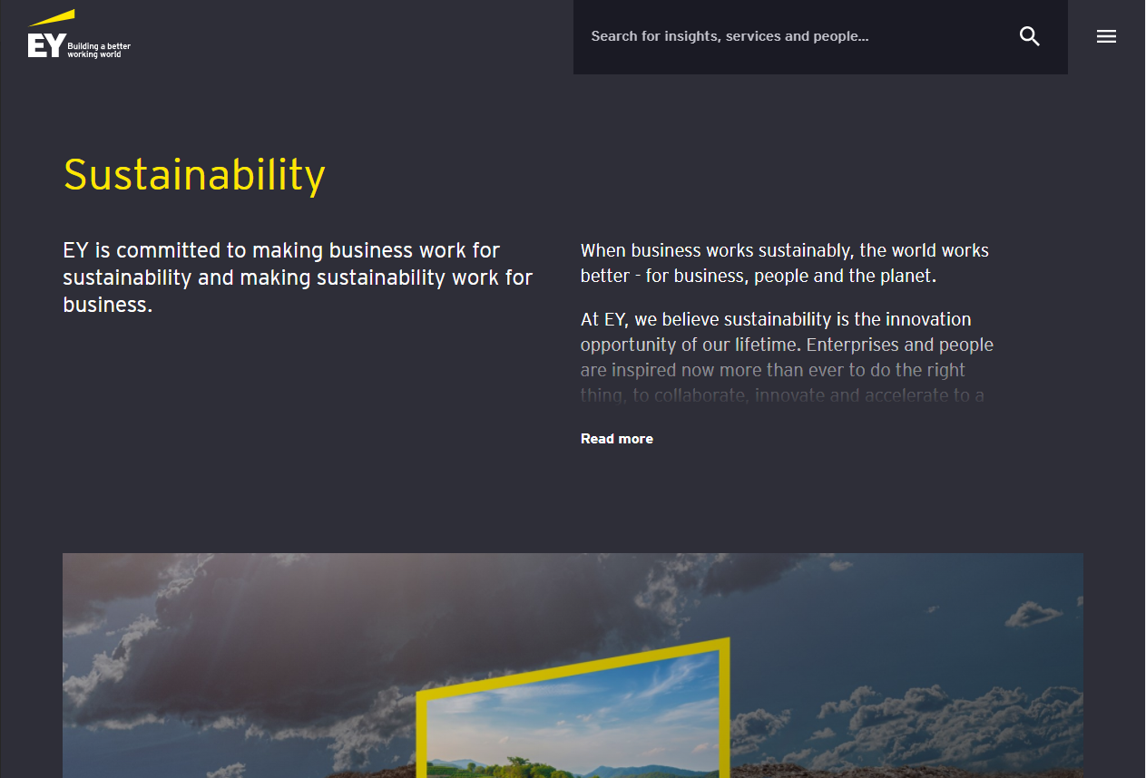
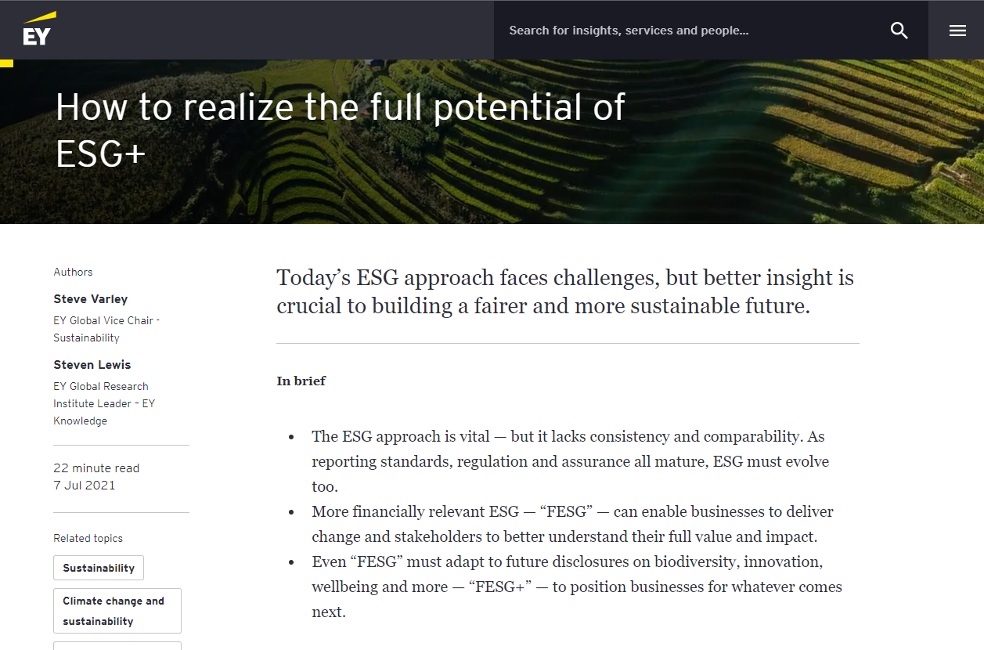
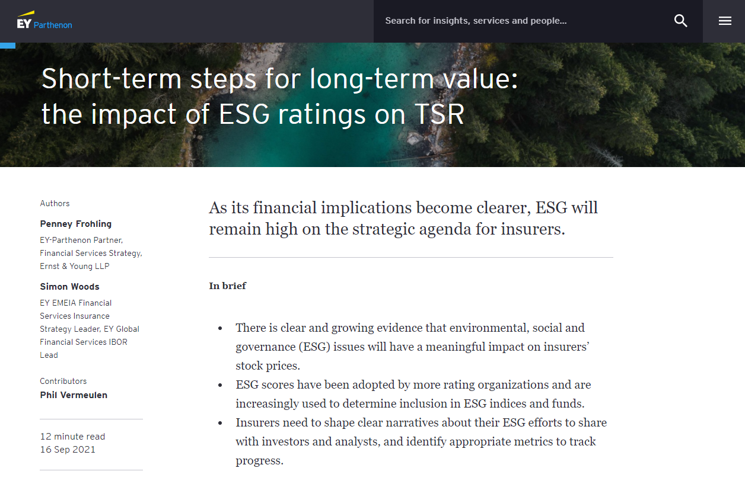
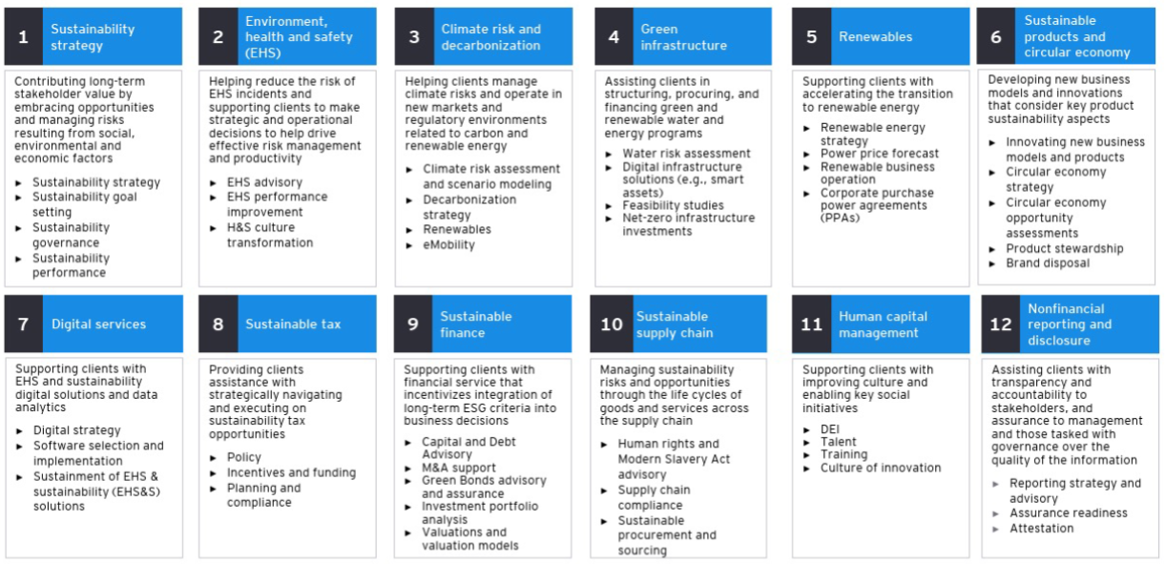
ESG Ratings Platform solution is developed in-line with EY’s Sustainability Strategy and Goals
ESG Ratings Platform connects regulators and corporations by providing data transparency
Convergence - of internationally recognized ESG principles into a single platform for consistent decision making
Adoption - of ESG Ratings Platform to enable scalability and improvement of platform intelligence across time
Assurance – with holistic ESG data aggregation across both company-submitted documents and external sources
Innovation – through Machine Learning/Artificial Intelligence embedded in decision making
Our solution provides an avenue for enhanced ESG-related nonfinancial reporting and disclosure
Achieving the goal of providing enhanced “Nonfinancial Reporting and Disclosure” through built-in features of ESG Ratings Platform:
Reporting Efficiency – integrated platform with aggregation of ESG data and principles
Data Transparency – with combination of voluntarily disclosed documents and external source of information
Nonfinancial Data – aggregation of non-financial data such as news, policies to supplement decision making

Slide 9
3-stage roadmap focusing first on prioritized features like ESG Data Aggregation to tackle the obstacle of data transparency
JJ
MVP 1: ESG Data Aggregator
MVP 2: ESG Evaluation (Rules-Based)
MVP 3: ESG Evaluation (AI/ML)
Description
MVP 1 addresses need for a single source of truth for ESG related data – both corporations voluntarily disclosed and external sources
Description
MVP2 builds on the holistic data available to evaluate green loans/bonds eligibility based on internationally recognized principles through rule-based systems
Description
MVP3 leverages on wealth of historical data of eligibility evaluation cases to train AI/ML models to evaluate eligibility for sustainable financing products
Features
Company Documents Processing – NLP techniques to structure voluntarily disclosed documents
External ESG Data – web-scraping to obtain additional company-related ESG data
(Additional) Features
Aggregator of ESG principles – web-scraping to identify latest international ESG principles/criteria
Rule-Based Green Loans/Bonds Automated Evaluation – evaluation of eligibility for green financing products through matching of company ESG data against ESG principles
(Additional) Features
AI/ML-based Green Financing Products Evaluation – enhanced evaluation of eligibility for green financing products through prediction/forecasting of relevant ESG metrics (i.e. ability to meet SPTs, green loan default probability etc.)
Data Sources
Company-submitted Documents
Annual Reports
Media/News Articles
Rating/Auditing Agency
(Additional) Data Sources
Websites/documents with ESG principles
(Additional) Data Source
Historical data of eligibility evaluation cases

Slide 10
Appendix

Slide 11




Team Member
Arindom B.
DATA ENGINEER
Senior Manager
Ramkumar R.
DATA SCIENTIST
Manager
Jia Jun T.
DATA SCIENTIST
Senior Consultant
Fremont Z.
DATA SCIENTIST
Senior Consultant
Arindom is a Data Engineer in FSO – Data & Analytics team specializing in architecting, developing and implementation of large scale enterprise data lakes across Insurance, Banking and Private Equity sectors.
He wants to contribute towards a sustainable future for our planet by using his knowledge and experience in Data & Analytics.
Ram is a Data scientist in FSO Consulting - Data & Analytics with 11 years of experience in building analytics solutions in Banking and financial sector.
He has developed and deployed several End-to-End Machine learning solutions involving conceptualization, Development, Deployment and Monitoring.
Jia Jun is a Data Scientist in FSO Data & Analytics, specializing in E2E analytics solutions ranging from translating business problems, building ETL pipelines, machine learning modelling and model deployment. He is a Certified Scrum Master (CSM) and Certified Scrum Product Owner (CSPO).
Prior to joining EY, he was in a Graduate program in a top Singapore bank and had experience in both Consumer and Institutional banking analytics.
Fremont Zhao is a Data Scientist specializing in managing and developing end-to-end data analytics and process optimization projects.
He is adept at formulating business analytic process and accommodating various data integration, data mining, machine learning, data visualization and AI platform technologies.

Slide 12
Reference / Useful Information
Theme | Links
Responsible Production & Green Consumption | https://www.un.org/sustainabledevelopment/sustainable-consumption-production/
Sustainable Financing / Sustainable Loans | https://extension.harvard.edu/blog/what-is-sustainable-finance-and-why-is-it-important/ https://www.wwf.org.uk/what-we-do/projects/why-sustainable-finance-important MAS Sustainability-Linked Loans: https://www.mas.gov.sg/schemes-and-initiatives/green-and-sustainability-linked-loans-grant https://investor.bankofamerica.com/fixed-income/esg-themed-issuances https://ec.europa.eu/commission/presscorner/detail/en/QANDA_21_3406 https://www.spglobal.com/marketintelligence/en/news-insights/latest-news-headlines/sustainability-linked-loan-supply-outpaces-green-bonds-and-loans-amid-us-surge-65569374
ESG Rating | https://www.fidelity.com.sg/beginners/esg-investing/esg-ratings https://www.ey.com/en_jo/financial-services-emeia/short-term-steps-for-long-term-value-the-impact-of-esg-ratings-on-tsr https://www.ey.com/en_sg/sustainability/realize-potential-esg-plus https://www.sustainalytics.com/esg-research/resource/corporate-esg-blog/introduction-to-sustainability-linked-loans-and-esg-ratings https://corpgov.law.harvard.edu/2017/07/27/esg-reports-and-ratings-what-they-are-why-they-matter/
Data Sources | https://datatopics.worldbank.org/esg/dashboards.html https://www.sgx.com/securities/annual-reports-related-documents
Others | https://www.businesstimes.com.sg/banking-finance/new-platforms-to-tackle-esg-data-gaps-in-singapore

